Slide 1
2-4 Conditional Probability
To introduce conditional probability, consider an example involving manufactured parts.
Let D denote the event that a part is defective and let F denote the event that a part has a surface flaw.
Then, we denote the probability of D given, or assuming, that a part has a surface flaw as P(D|F). This notation is read as the conditional probability of D given F, and it is interpreted as the probability that a part is defective, given that the part has a surface flaw.

Slide 2
2-4 Conditional Probability
Definition

Slide 3
2-5 Multiplication and Total Probability Rules
2-5.1 Multiplication Rule

Slide 4
2-5 Multiplication and Total Probability Rules
2-5.2 Total Probability Rule
Figure 2-15 Partitioning an event into two mutually exclusive subsets.
Figure 2-16 Partitioning an event into several mutually exclusive subsets.

Slide 5
2-5 Multiplication and Total Probability Rules
2-5.2 Total Probability Rule (two events)

Slide 6
2-5 Multiplication and Total Probability Rules
Total Probability Rule (multiple events)

Slide 7
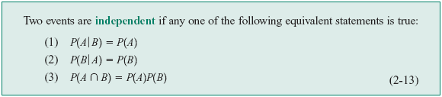
2-6 Independence
Definition (two events)

Slide 8
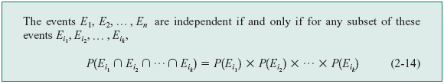
2-6 Independence
Definition (multiple events)

Slide 9
Example 2-34

Slide 11
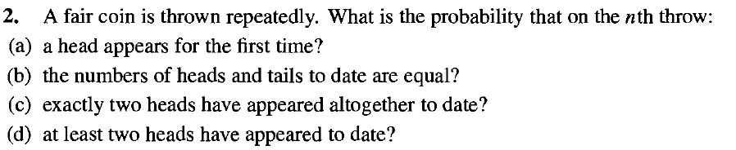

Slide 12
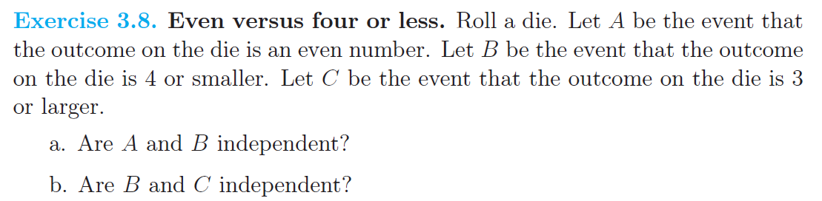

Slide 15
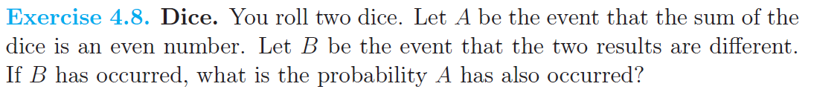

Slide 16
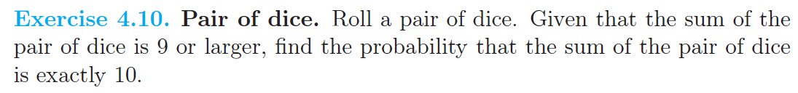

Slide 17
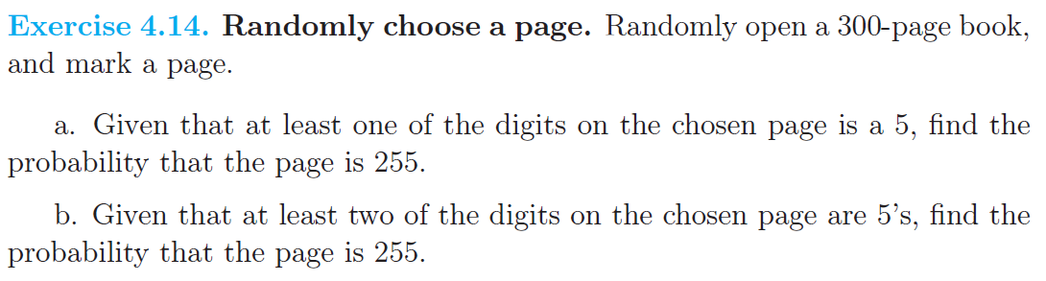

Slide 18
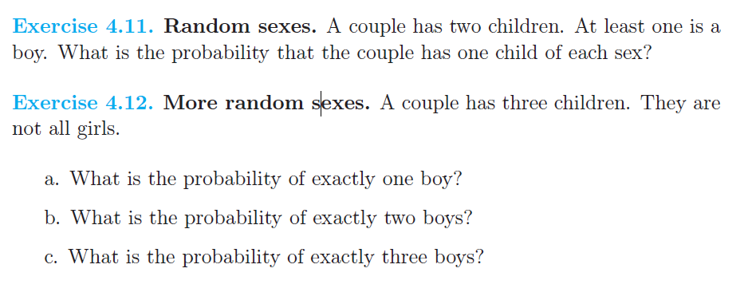

Slide 23
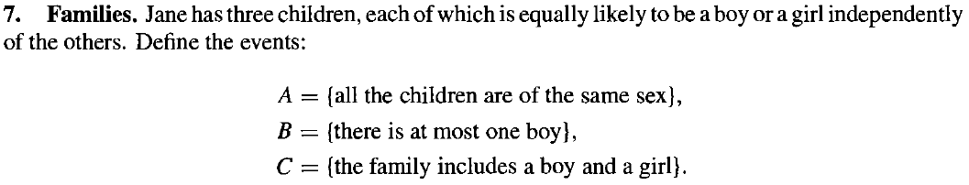

Slide 24
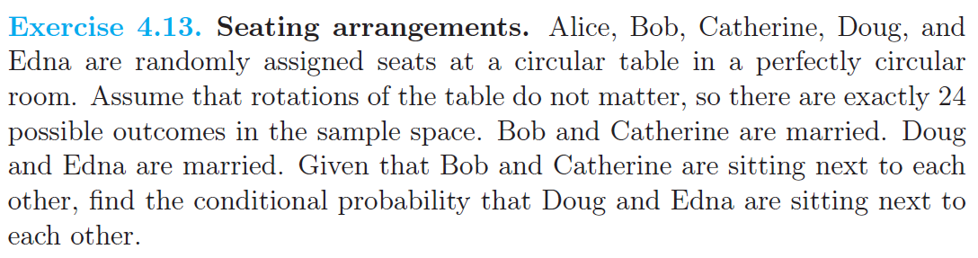

Slide 25

2-7 Bayes’ Theorem
Definition

Slide 26
2-7 Bayes’ Theorem
Bayes’ Theorem

Slide 27
2-8 Random Variables
Definition

Slide 28
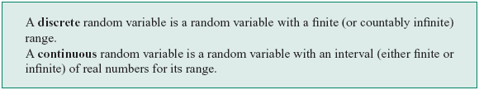
2-8 Random Variables
Definition

Slide 29
2-8 Random Variables
Examples of Random Variables

Slide 30
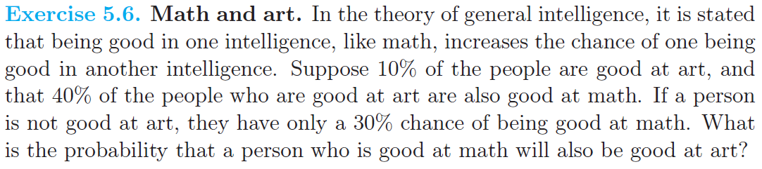

Slide 31
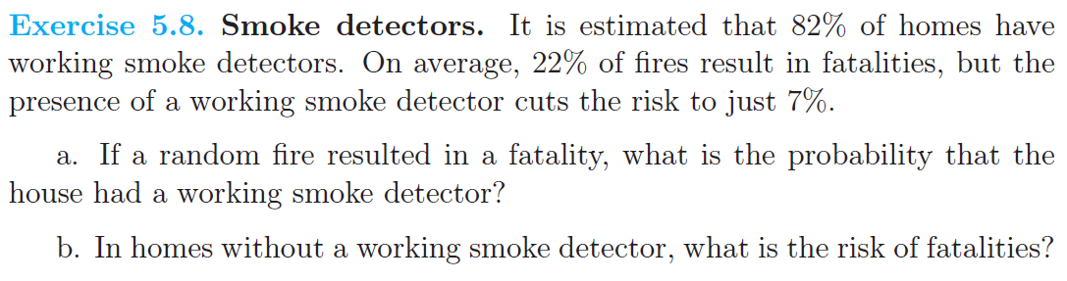

Slide 32
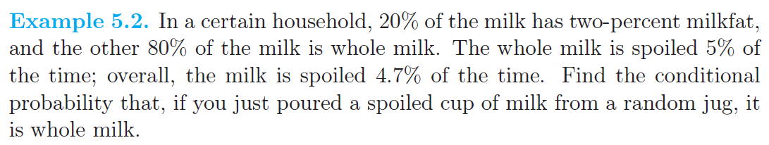

Slide 34
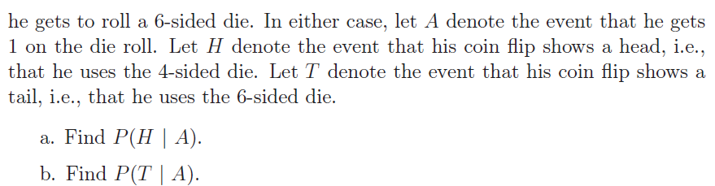

Slide 35
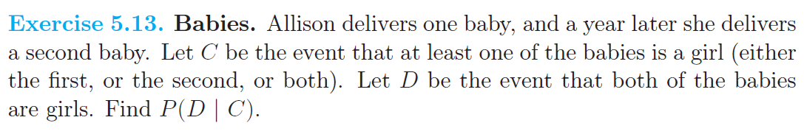

Slide 36
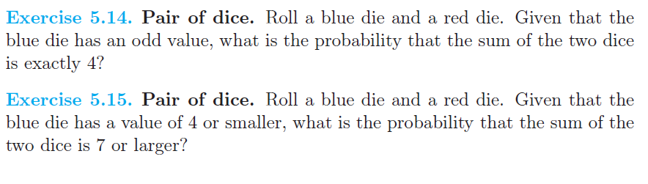

Slide 37
